Slide 1
DEP 202 DATA ANALYSIS
COSMOPOLITAN UNIVERSITY
DATA ANALYSIS EXAMS ON SALES PERFORMANCE DASHBOARD USING EXCEL DONE BY ME
NENE PERPETUAL OKOGO / DA/SWC/202/2026

Slide 2
Business Scenario (Problem Statement)
You are a Junior Data Analyst working for a retail company.
Management wants to understand:
Which products sell the most
Which region generates the highest revenue
Which sales representative performs best
How sales performance can be improved
Your task is to analyze the dataset using Microsoft Excel.

Slide 3
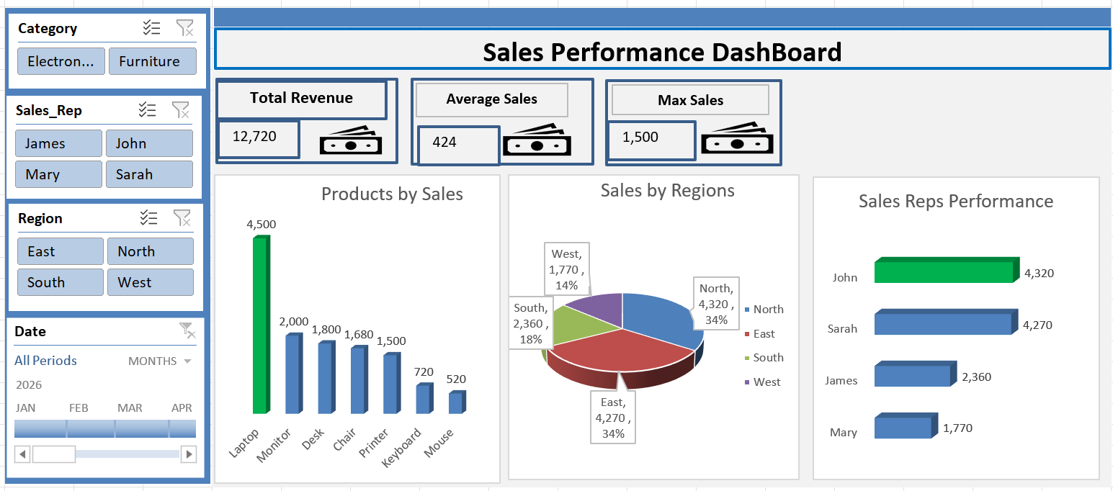
SALES ANALYSIS DASHBOARD

Slide 4
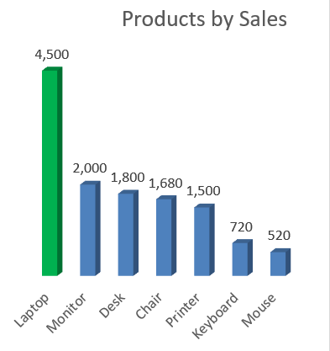
1. Which products sell the most
Based on the findings, the product that sells best is Laptop with a total sales of 4,500

Slide 5
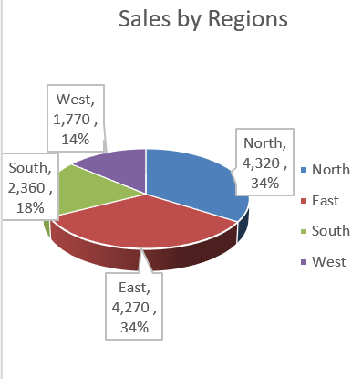
Which region generates the highest revenue
The region with the highest revenue is North. Has a total revenue of 4,320

Slide 6
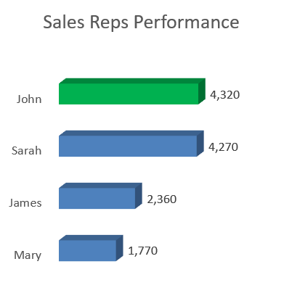
Which sales representative performs best
The best performing sales representative is John with sales performance of 4,320

Slide 7
Recommendations
The mouse sales needs to be improved upon. Incentives should be included in the sales of mouse for example, buy 2 mouses and get a free flash drive of 8 gig.
The best sales representative should be deployed to the worst sales region to help or teach other sales representatives skills on how to improve their sales in their region. And also, a lot of awareness and marketing should be done in this region.
Incentives should be made competitive so all the sales representatives can be on their toes, to do better with their targets and sales.

Slide 8


